Slide 1
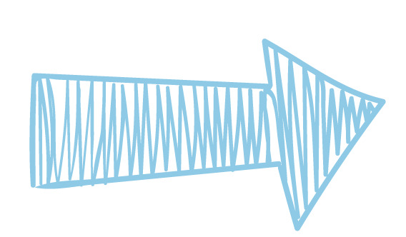

NECT Project (40%)
By: Shubham, Xin Yu, Tevian, Yi Jie

Slide 2
Overview
Assumptions, AWS services and network design
Wireless connectivity
Wired connectivity
File and printer sharing
Sustainability proposals

Slide 3


Our assumptions [Xin Yu]
01
Scenario for Green family
Assumptions made
3 level house: main router on 2nd floor, rest of the house have mesh routers and switches for Green family's seamless connectivity
IoT devices connected to cloud for easy control
We checked that IoT devices bought a month ago & CLS certified
Plans to add solar panels for alternate green energy source
Considered for AWS free tier to store many and big sized files on cloud
Mostly WFH (working from home)
Users want easy administrative controls

Slide 4

Cloud Services-AWS (Networking & Content Delivery Services)
Amazon VPC
AWS VPC allows its users to create logically isolated section of the AWS cloud where they can launch AWS resources in a virtual network.
- Users can create multiple subnets, each serving a specific purpose and logically isolated from one another. These subnets allow better organization, management, and security of resources. [e.g., security-related subnet, personal devices subnet & etc.]
Notes:
Virtual Network: A virtual network is like a digital version of a physical network of devices, such as computers, smartphones, and servers, but it exists entirely in a software environment rather than being physically connected by cables and hardware.

Slide 5
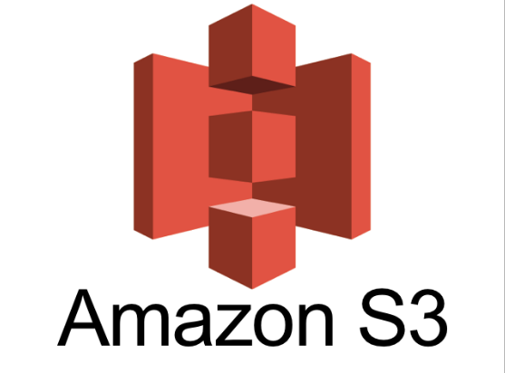
Cloud Services-AWS (Storage)
Amazon S3 (Amazon Simple Storage Service)
-To allow organizations, individuals & etc. to store and retrieve any scale of data over the internet.
Security measures (for confidentiality) :
Access-Control (ACLs)
Server-side encryption
Uses of S3 in our project:
IoT
Store and manage data generated by the devices which we can identify potential equipment failures.
Security camera
Store its recording data in S3 to ensure its secure.

Slide 6


Cloud Services-AWS (Security)
AWS IAM (Identity Access Management)
-Helps securely manage identities and access to AWS services and resources.
-Able to specify who or what can access services and resources in AWS, and centrally manage fine-grained permissions.
Amazon Cognito
-An identity platform for web and mobile apps, which allows user admins to be able to authenticate and authorize users from the built-in user directory.

Slide 7
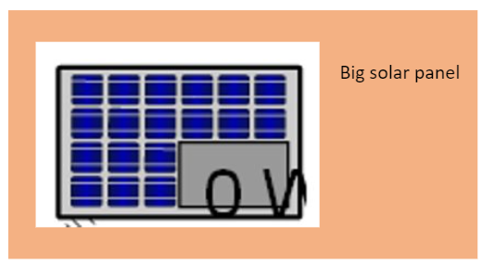
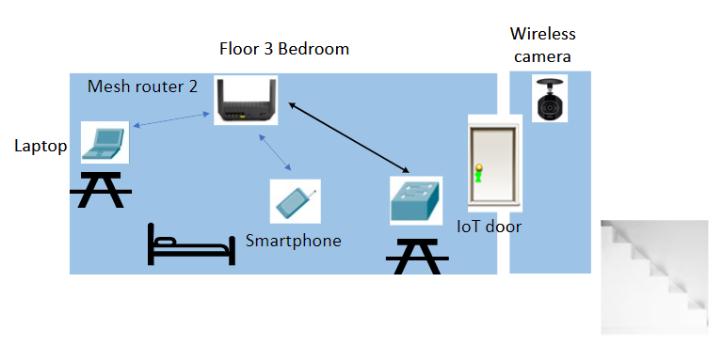
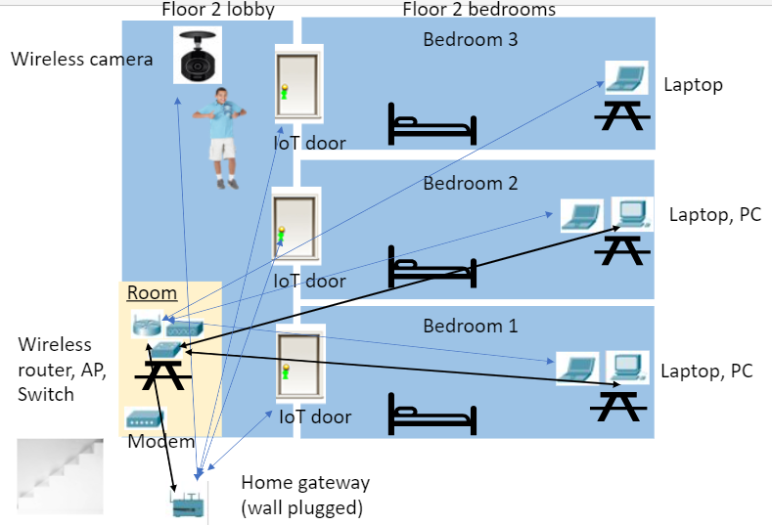
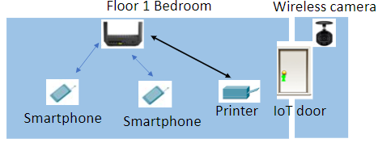
Network Design (Physical Topology)

Slide 8
Network Design (Physical Topology)[Continuation]
(Legend) means straight- through
means cross- over
means wireless

Slide 9
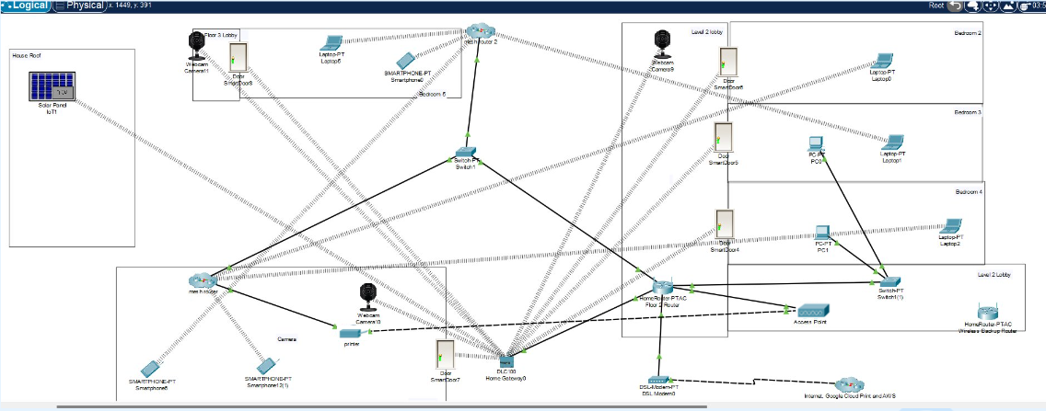
Network Design(Logical Topology)

Slide 10
Wireless Connectivity
02
Solar panel:
-We installed a big, high-quality solar panel on the rooftop of the house, with a battery in the attic.
Why?
Installing it helps to contribute to around 20-25% of the total energy needs and cuts carbon emission whilst being environmentally friendly.
Webcam camera:
-We used a webcam camera to identify any intruders/person trying to steal any personal data.
Why?
As a physical security measure to prevent the loss of personal data.

Slide 11
Wireless Connectivity
02
Smart door:
-We used a smart door to prevent intruders/unauthorized personnel from entering the rooms containing the data.
Why?
As a physical security measure to prevent the loss of personal data.
Smartphone & Laptop:
-These devices are able to access the AWS cloud via the home gateway and control the IoT devices.
Why?
So that we can view for e.g webcam camera data.

Slide 12
Wired Connectivity
03
Access point
- Access point is connected to the home router via Copper-straight through wire it also provides wireless connectivity to devices. They act as a central hub connecting laptop or phones to the LAN without the use of physical cables
Why?
Access point help to expand the coverage area of the LAN
They distribute the network load more evenly, ensuring better performance and reliability for connected devices.
Home gateway
- Home gateway is connected to the main home router using Copper-straight through wire. Home gateway wirelessly connects to IoT devices such as Webcams, Smart Doors, & etc.
Why?
Home gateway provides connectivity between IoT devices and end devices such as mobile phones.
With our phones, we can control and monitor IoT devices.
Facilitates the transmission between IoT devices to the cloud (e.g. AWS)

Slide 13
Wired Connectivity
03
Mesh router
-We used mesh routers to extend Wi-Fi coverage throughout the house, putting it at level 1 & 3 .
Why?
To eliminate dead zones, improve signal strength, and ensure consistent and seamless internet access across multiple floors and rooms.
Switch
-We used switches to connect several devices such as 2 PCs and 2 mesh routers to the main router.
Why?
To expand port availability, manage network traffic efficiently, and ensure smooth data transmission for improved connectivity and performance.

Slide 14
Wired Connectivity
03
Modem
-Connected a modem to the main router to establish connection between the home network and internet service provider.
Why?
To access high-speed internet services, enabling communication with online resources and services from within our home network.

Slide 15
File & Printer Sharing
04
What factors play a role in a printer’s connectivity;
Printer’s Location
Network Requirements
Availability of Resources
What type of connectivity?
- Wired Connectivity
- Wireless Connectivity
Either type of connection is viable but the choice depends
on the needs of the Green Family & the constraints that
exist in the LAN(Local Area Network) of the Green family’s house
File & Printer Sharing
- Printer is connected to the home router
- Printer is connected to Google Cloud Print

Slide 16
Sustainability [Shubham] (Insight & Solution)
05
1. Have a Higher Density of Devices in the house
- This allows for the efficient utilization of the resources
- With low-density network, there isn’t any optimization of the available resources
- Reduced redundant infrastructure → waste reduction , energy conservation & resource efficiency
2. Do not throw away old network devices. Instead recycle them
- Organizations recycling Electronic Devices would collect and recycle electronic waste.
- This minimizes the environmental impact → lesser carbon footprint
(especially considering the increasing dependance of the electronic dependency coming )
3. Usage of Dynamic Routing Protocols
- Adapts to changes in the network according to the traffic patterns
- Removes unnecessary data transmission
- Reduces the energy consumption, saving electricity → lesser carbon footprint
Notes:
High user density:
In a household can offer numerous benefits, including improved connectivity, customized user experiences, and enhanced collaboration. While challenges such as network congestion and security risks may arise, these can be addressed through proactive measures and optimization strategies. Ultimately, the decision to maintain a high user density depends on individual preferences and the ability to effectively manage the associated complexities.
Resources:
"resources" typically refer to various components and capabilities within the network infrastructure

Slide 17


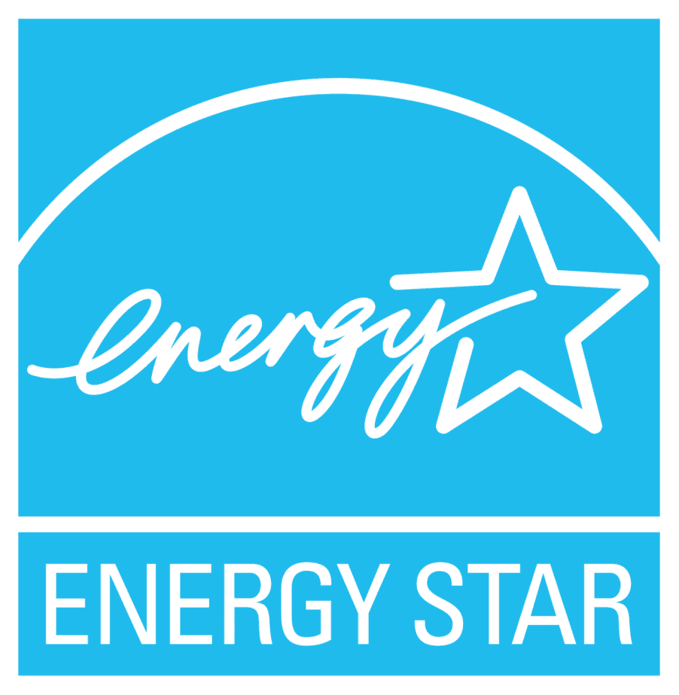
Sustainability (Xin Yu)
05
AC automatic timers
Solar panels on roof
"Energy star" graded devices
energy consumption supervision
To save energy, we've set timers to power down AC units when Green family not inside the house
In context of improved supervision on power consumption, Green family able to remotely monitor and control IoT devices
Upgraded devices with Energy Star certified,
consuming less energy while meeting
networking needs of Green family, hence
more savings other than the solar panels
Decided on one big, high- quality panel with a battery installed in the spacious attic, which contributes to around 20 –25 % of total energy needs and long-run savings

Slide 18
Sustainability (Tevian)
05
Energy-Efficient Network Switches
-Use switches that have power saving
features such as adjusting their power
Benefits:
Cost saving
Less power consumed ->
lesser carbon footprint=better for environment.
3. Smoother and more efficient due to the ability to adjust power based on when it is needed.
Low-energy Entertainment centre
-Using devices that saves energy like smart TVs with low power consumption and making use of smart power strips.
Benefits:
The power strips saves energy by cutting off power to devices in standby mode.
Lifespan increase for these devices
By using energy saving devices, it helps the entertainment system to be more efficient.

Slide 19
Sustainability (Yi Jie)
05
Implement edge computing for smart devices
Low-power IoT protocols
This decentralizes the storage, bringing them closer to data sources to enable faster responses and reduce data transmission to distant cloud servers. Overall, this makes it energy efficient.
Designed for devices with limited power capabilities, aiming to minimize energy consumption and reduce battery replacements which help reduce environmental footprints.

Slide 20
THANK YOU

